Slide 1
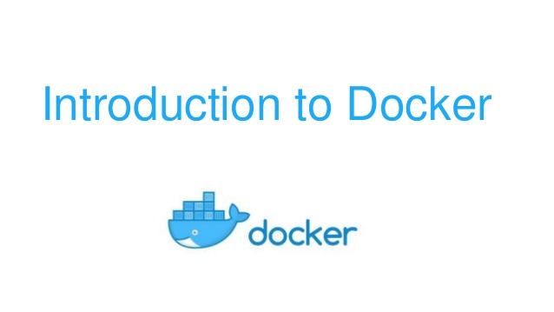

Slide 2
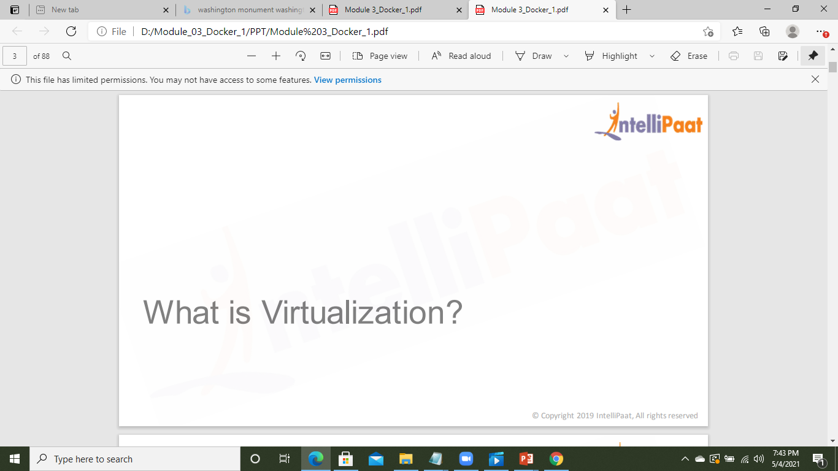

Slide 3
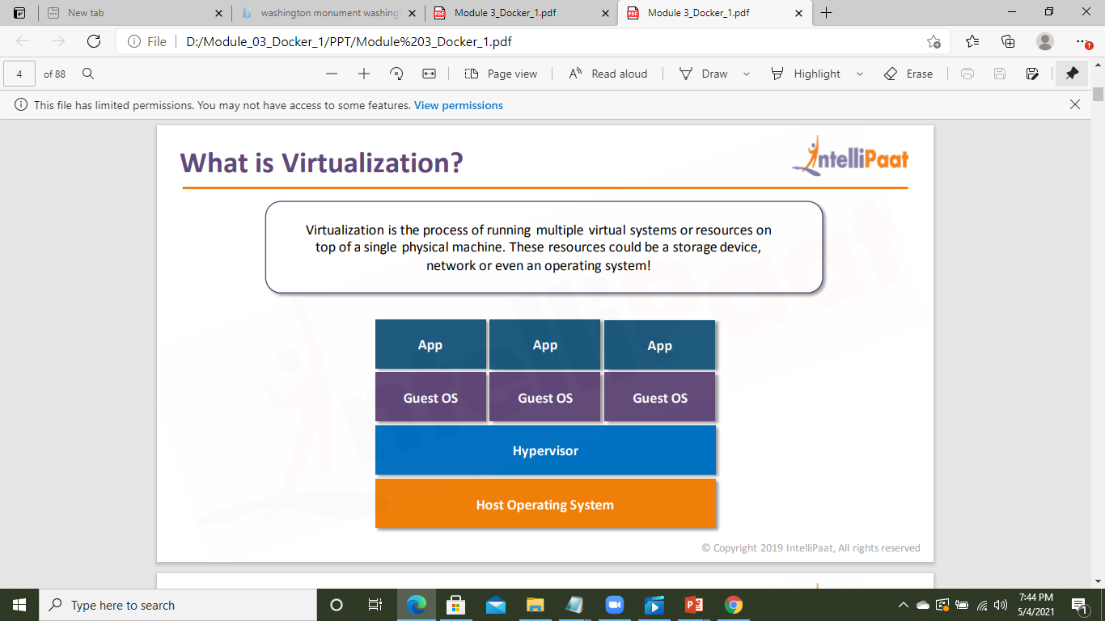
What is Virtualization?

Slide 4
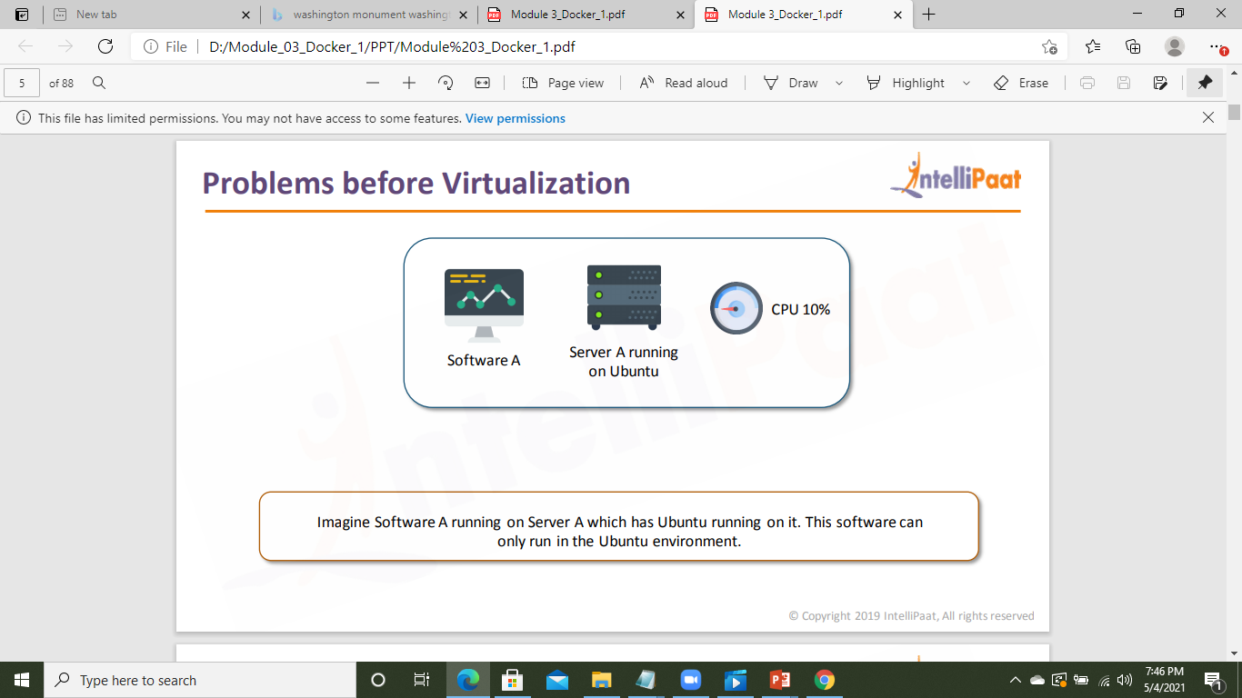
Problems Before Virtualization?

Slide 5
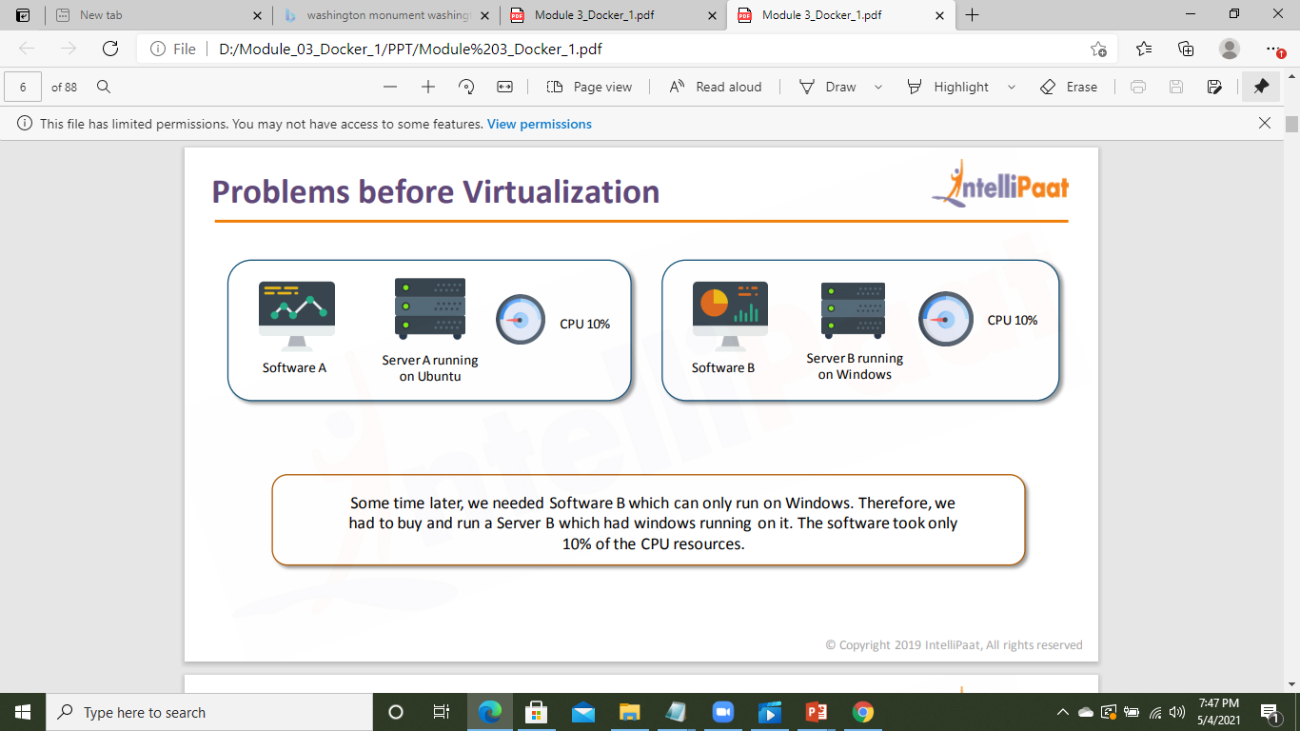
Problems Before Virtualization?

Slide 6
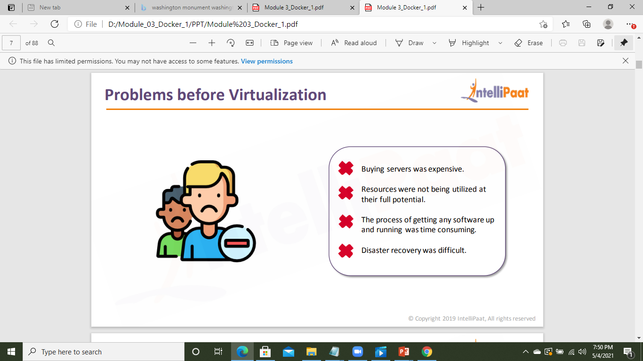
Problems Before Virtualization?

Slide 7
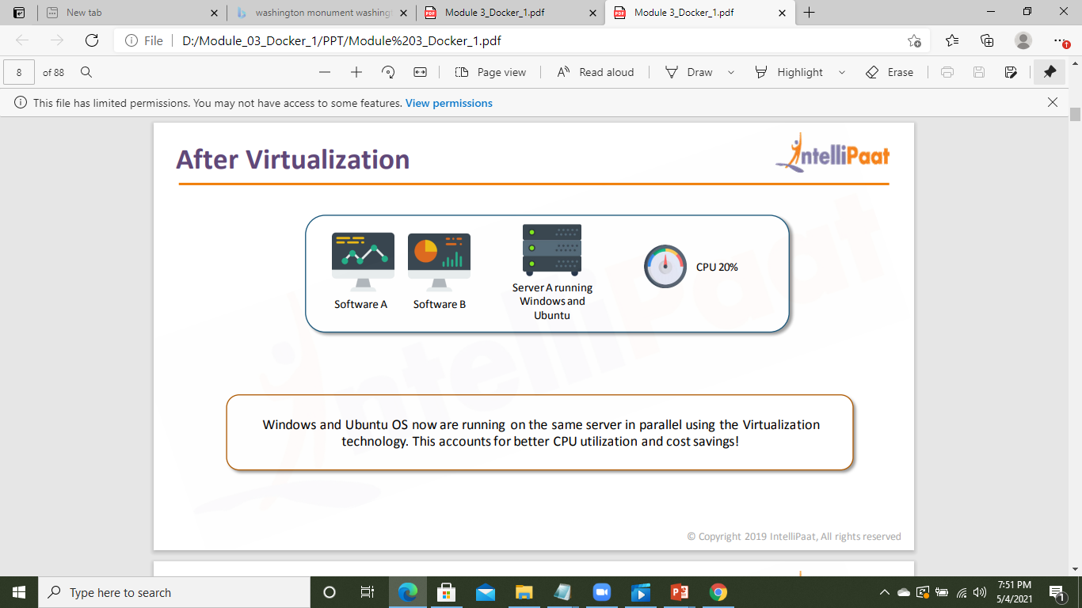
After Virtualization

Slide 8
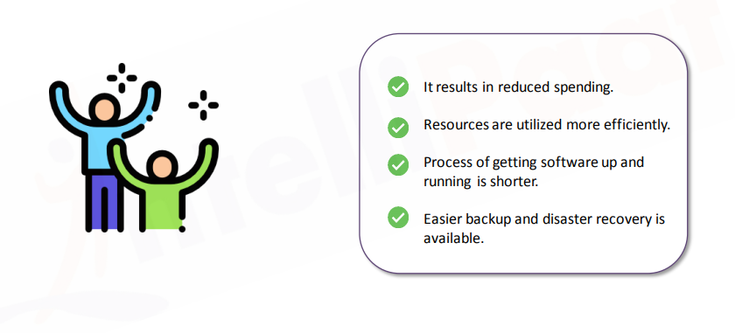
Advantages of Virtualization

Slide 9
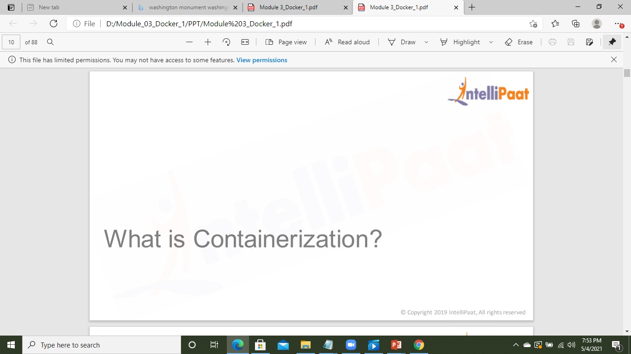

Slide 10
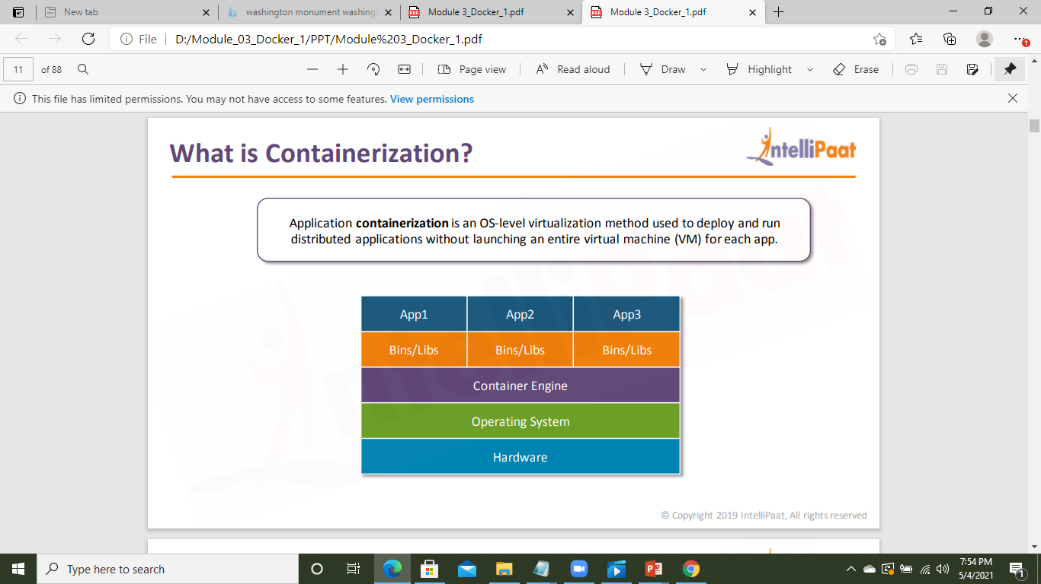
What is Containerization?

Slide 11
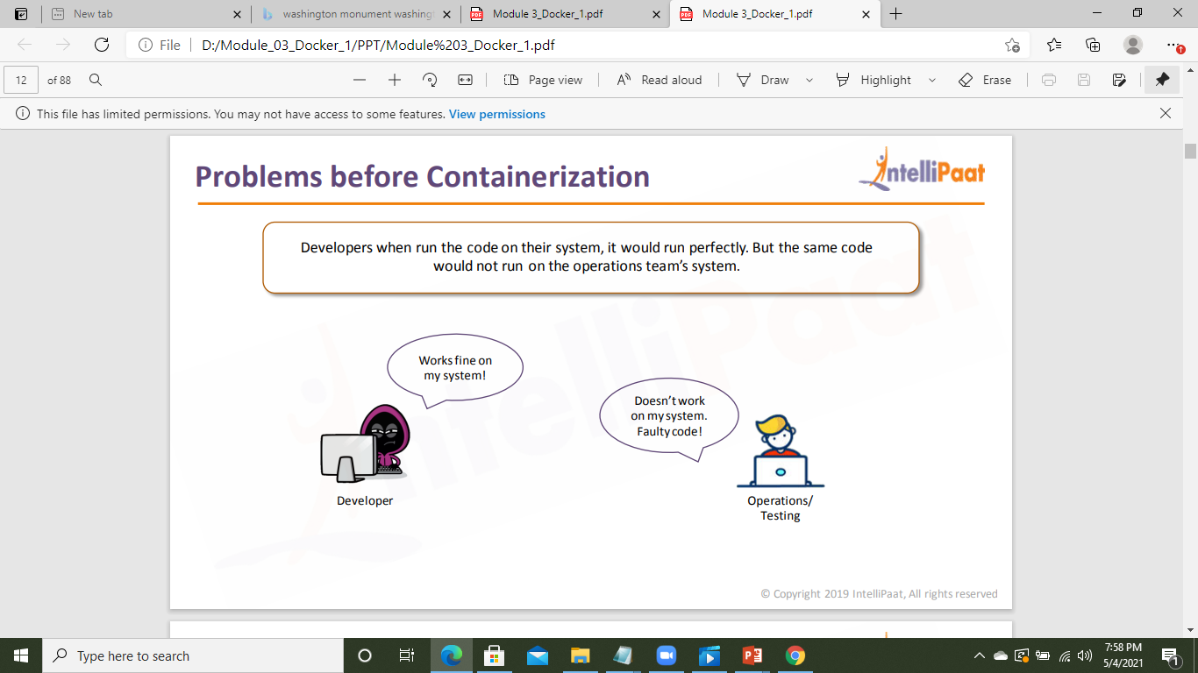
Problems Before Containerization?

Slide 12
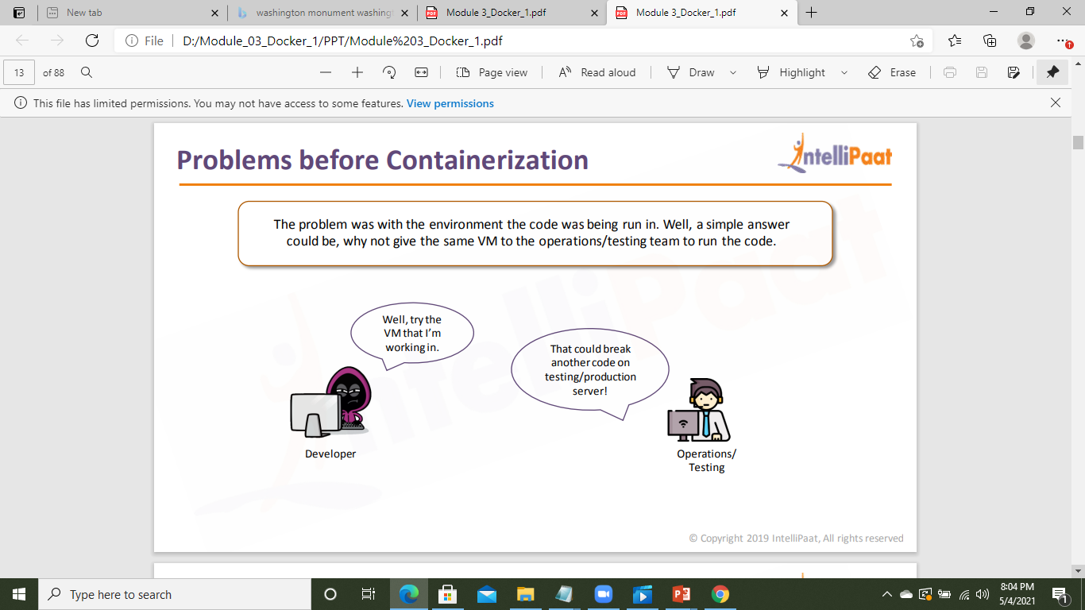
Problems Before Containerization?

Slide 13
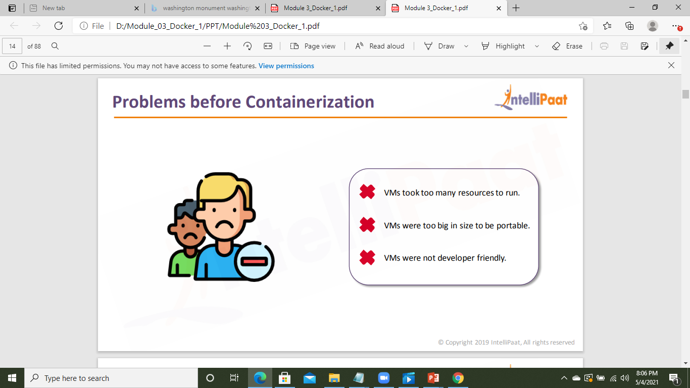
Problems Before Containerization?

Slide 14
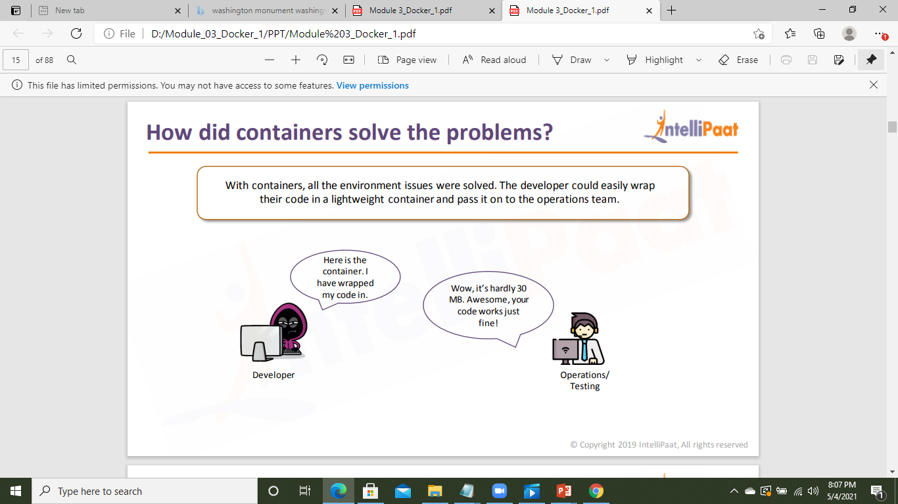
Containers solved the problems

Slide 15
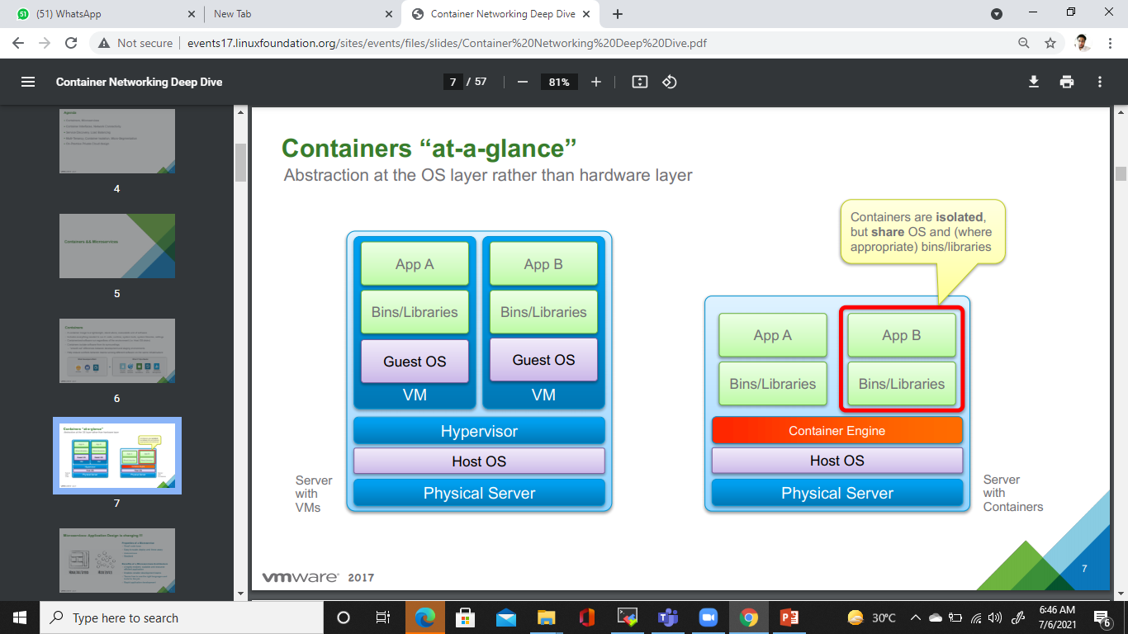

Slide 16
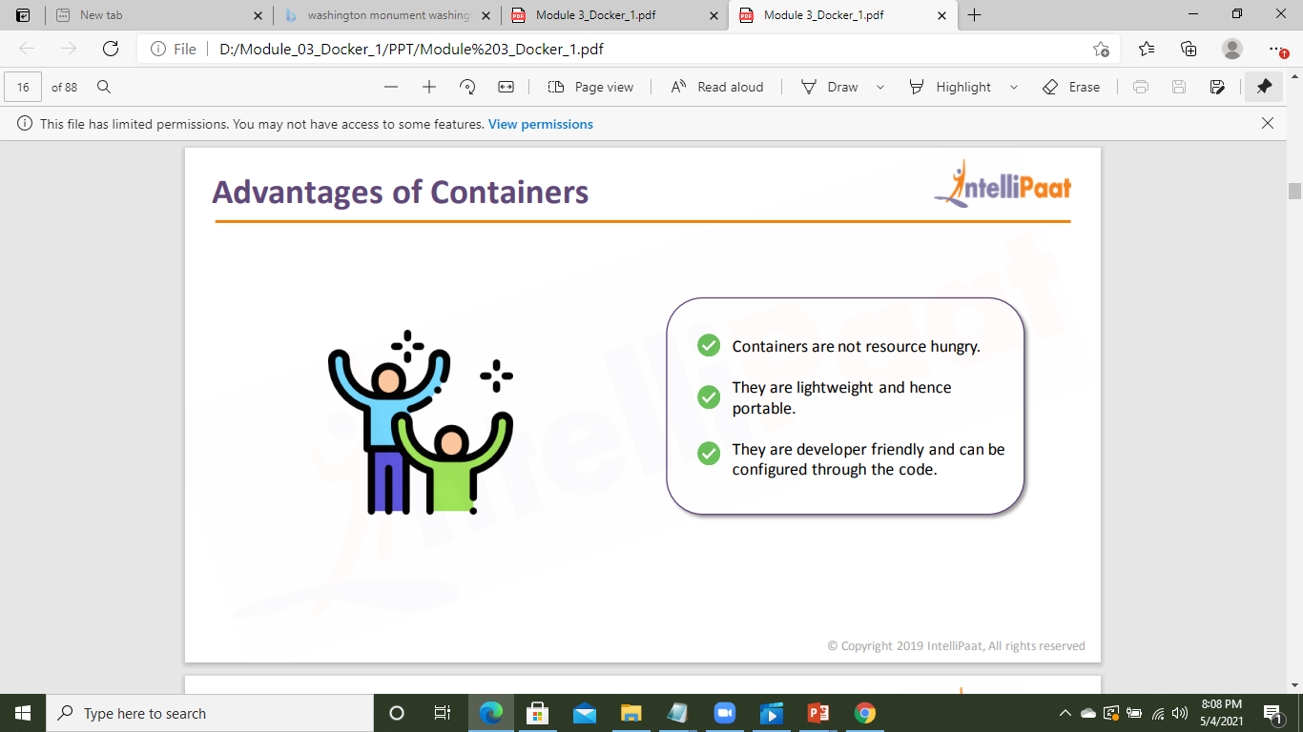
Advantages of Containers

Slide 17
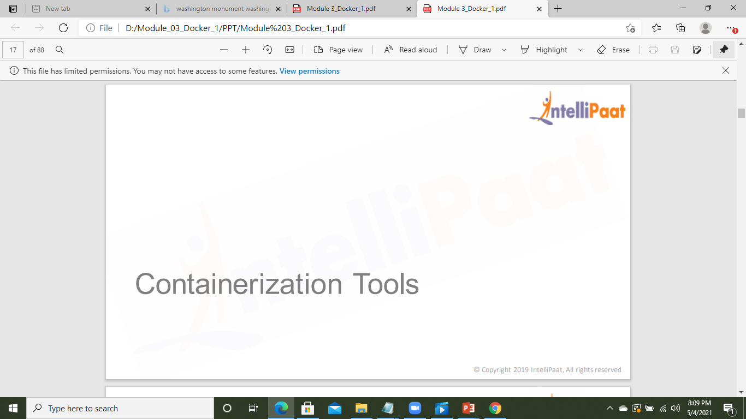

Slide 18
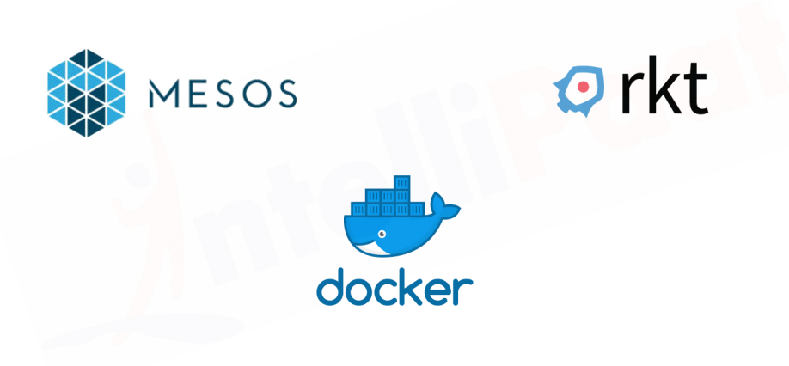
Containerization Tools

Slide 19
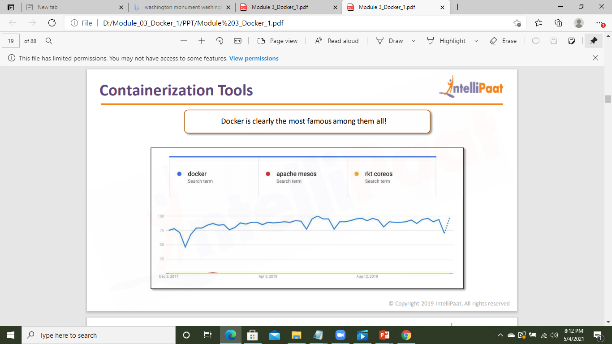

Slide 20
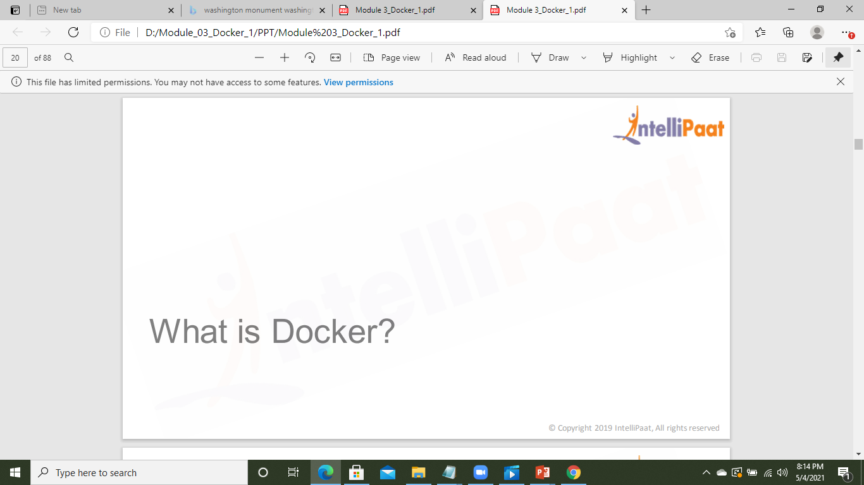

Slide 21
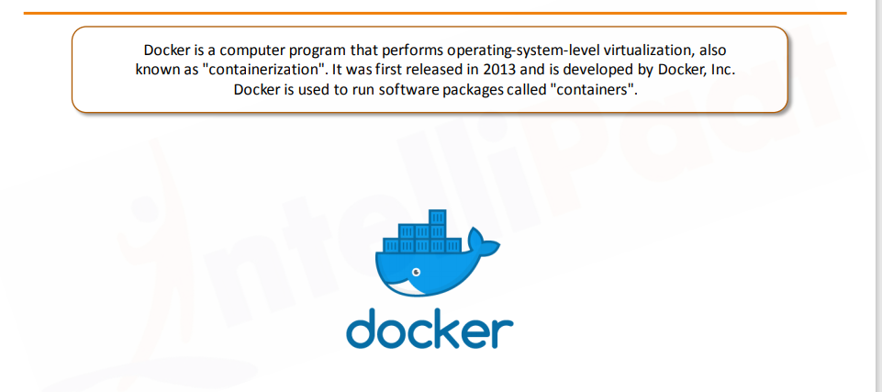
What is Docker?

Slide 22
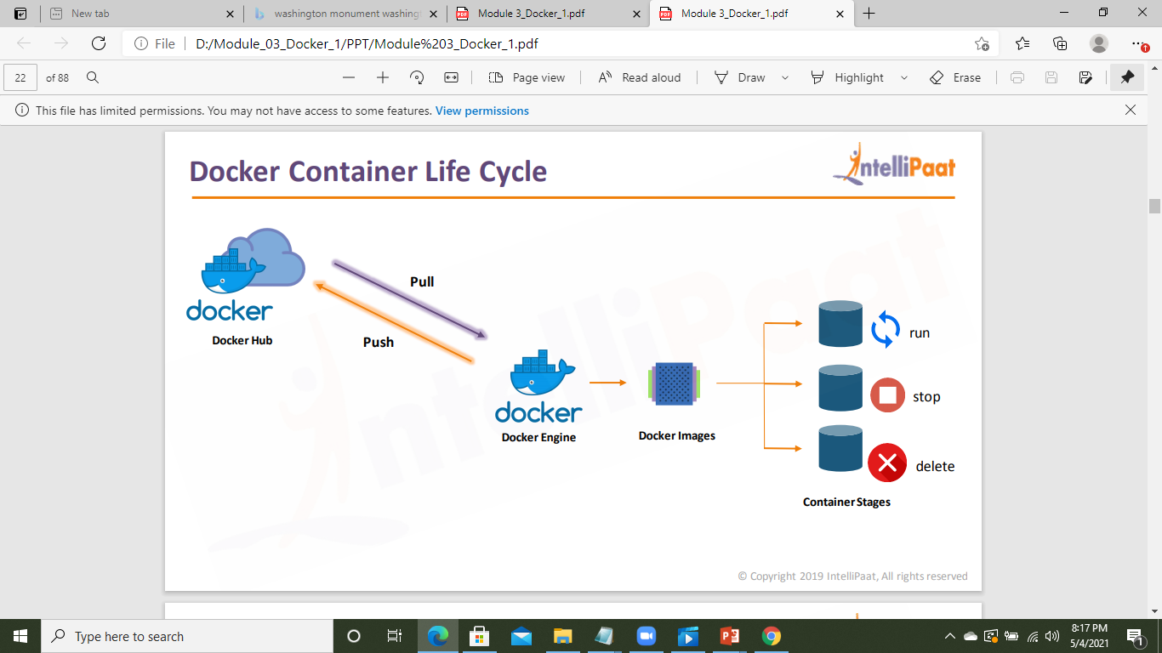
Docker Container Lifecycle

Slide 23
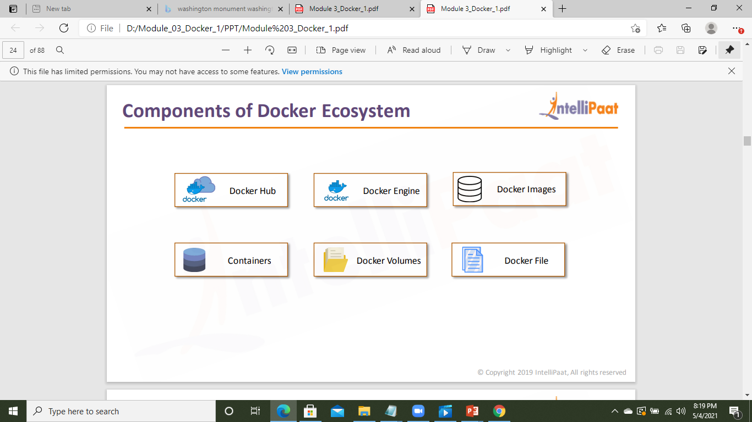
Components of Docker Ecosystem

Slide 24
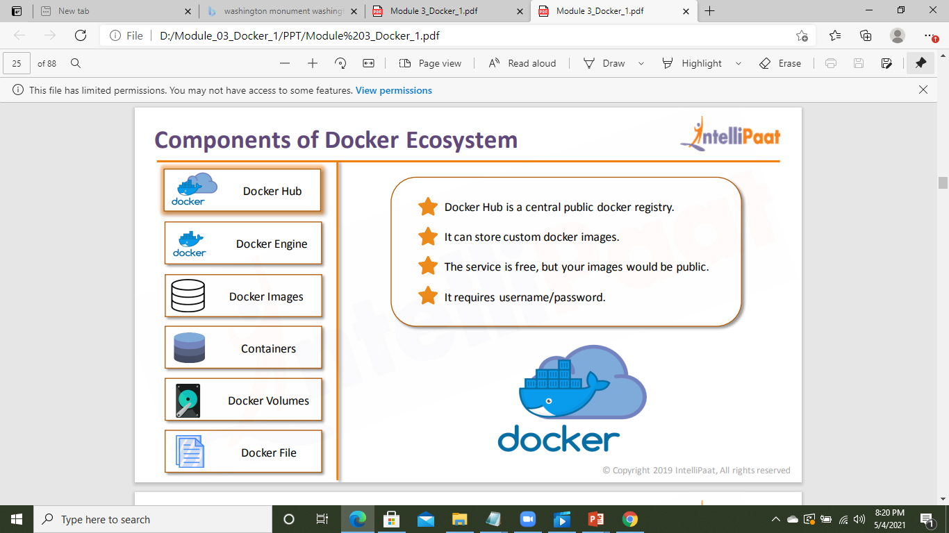
Components of Docker Ecosystem

Slide 25

Components of Docker Ecosystem

Slide 26
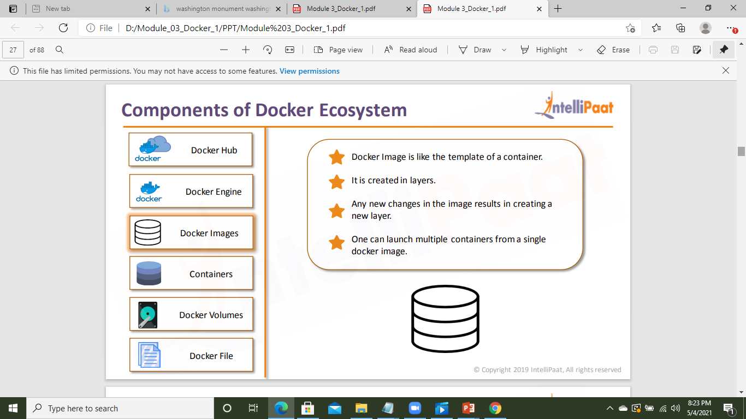
Components of Docker Ecosystem

Slide 27
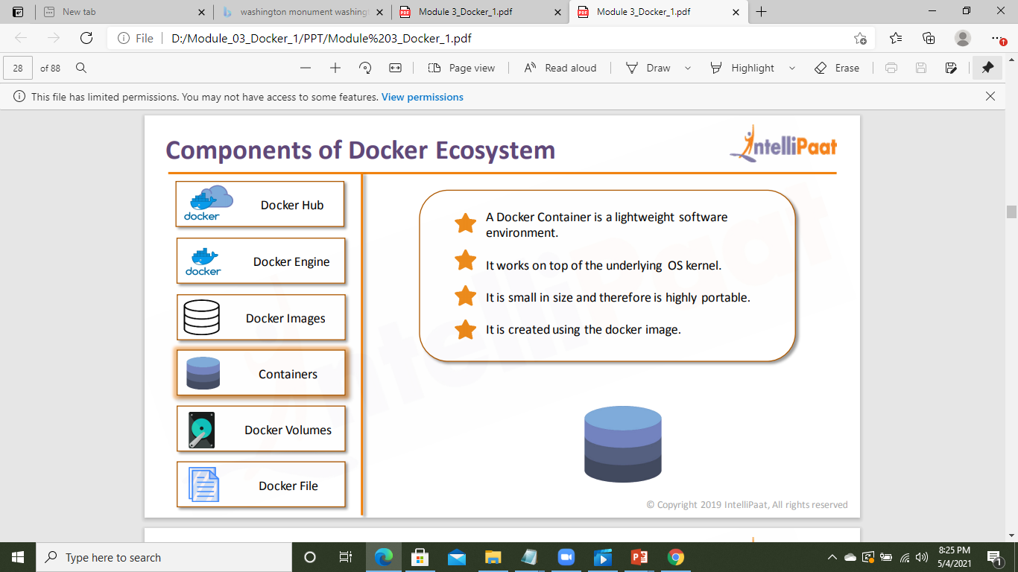
Components of Docker Ecosystem

Slide 28
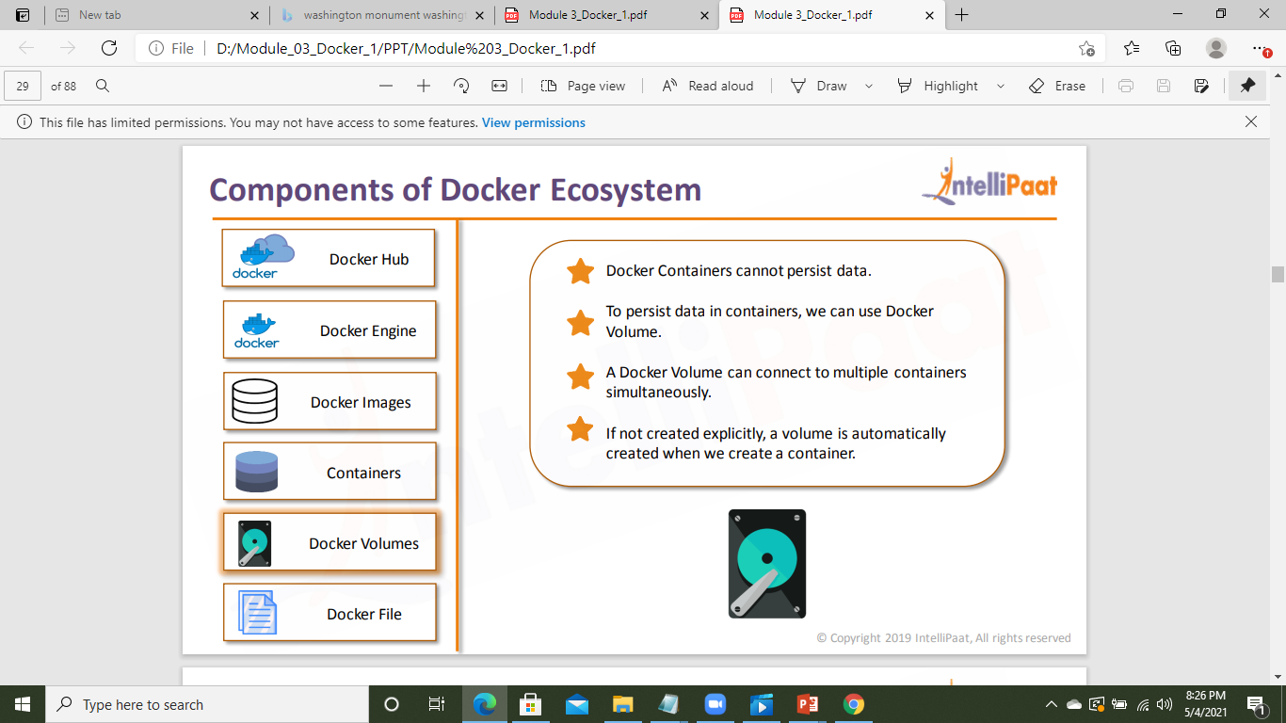
Components of Docker Ecosystem

Slide 29
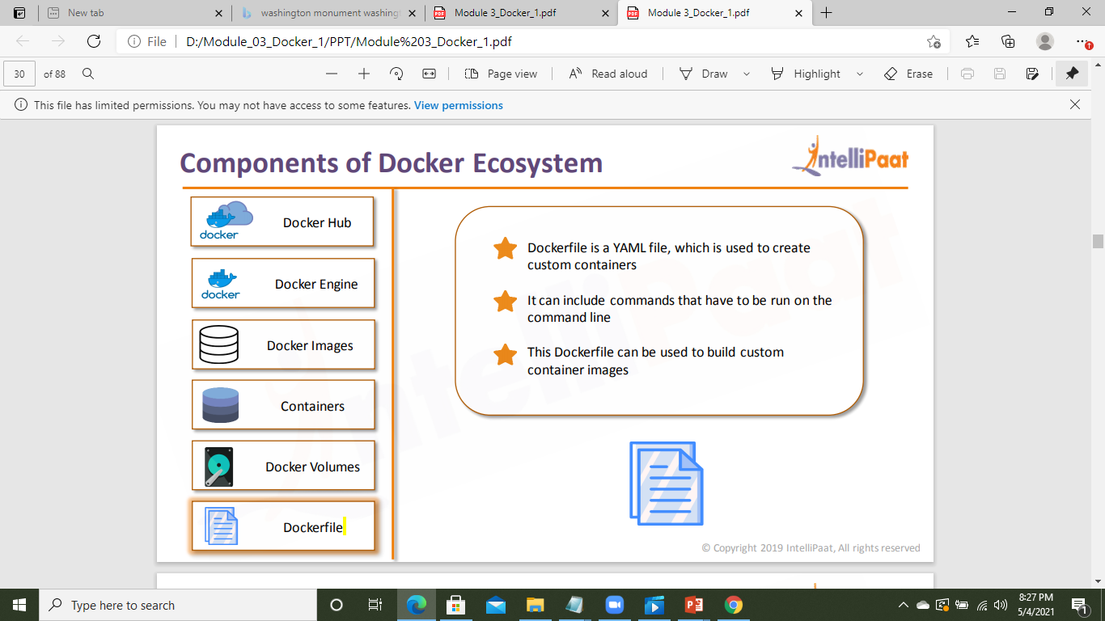
Components of Docker Ecosystem

Slide 30
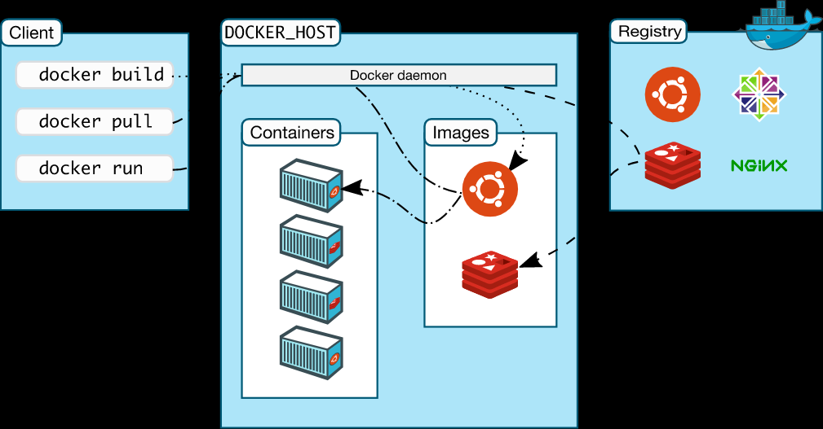
Docker Architecture

Slide 31
Docker Architecture
Docker uses a client-server architecture. The Docker client talks to the Docker daemon, which does the heavy lifting of building, running, and distributing your Docker containers.
The Docker client and daemon can run on the same system, or you can connect a Docker client to a remote Docker daemon.

Slide 32
Docker Architecture
The Docker client and daemon communicate using a REST API, over UNIX sockets or a network interface
The Docker daemon
The Docker daemon (dockerd) listens for Docker API requests and manages Docker objects such as images, containers, networks, and volumes. A daemon can also communicate with other daemons to manage Docker services.
The Docker client
The Docker client (docker) is the primary way that many Docker users interact with Docker. When you use commands such as docker run, the client sends these commands to dockerd, which carries them out. The docker command uses the Docker API. The Docker client can communicate with more than one daemon.

Slide 33
Docker Architecture
Docker registries
A Docker registry stores Docker images. Docker Hub is a public registry that anyone can use, and Docker is configured to look for images on Docker Hub by default. You can even run your own private registry.
When you use the docker pull or docker run commands, the required images are pulled from your configured registry. When you use the docker push command, your image is pushed to your configured registry.
Docker objects
When you use Docker, you are creating and using images, containers, networks, volumes, plugins, and other objects. This section is a brief overview of some of those objects.

Slide 34
Images
An image is a read-only template with instructions for creating a Docker container. Often, an image is based on another image, with some additional customization. For example, you may build an image which is based on the ubuntu image, but installs the Apache web server and your application, as well as the configuration details needed to make your application run.
Containers
A container is a runnable instance of an image. You can create, start, stop, move, or delete a container using the Docker API or CLI. You can connect a container to one or more networks, attach storage to it, or even create a new image based on its current state.
By default, a container is relatively well isolated from other containers and its host machine. You can control how isolated a container’s network, storage, or other underlying subsystems are from other containers or from the host machine.

Slide 35
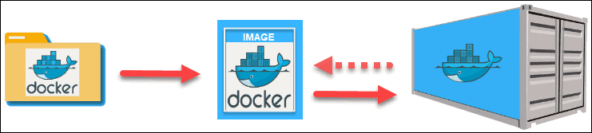
Docker Image vs Container

Slide 36
Docker Image vs Container
What are images?
If you’ve ever used virtual machines aside from Docker, you’ll be familiar with Docker images. In other virtual machine environments, images would be called something like “snapshots.” They’re a picture of a Docker virtual machine at a specific point in time. Docker images are a little bit different from a virtual machine snapshot, though. For starters, Docker images can’t ever change. Once you’ve made one, you can delete it, but you can’t modify it. If you need a new version of the snapshot, you create an entirely new image.

Slide 37
Docker Image vs Container
What’s a container?
We use the phrase “Docker virtual machine,” but the better way to say that is “Docker container.” If a Docker image is a digital photograph, a Docker container is like a printout of that photograph. In technical terms, we call it an “instance” of the image. Each Docker container runs separately, and you can modify the container while it’s running.

Slide 38
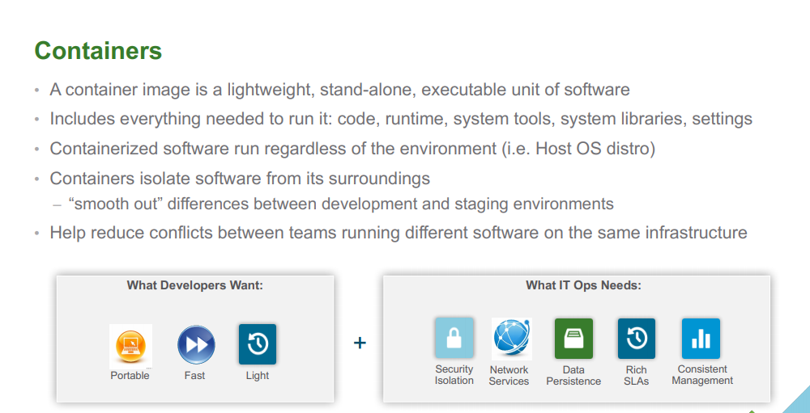

Slide 39
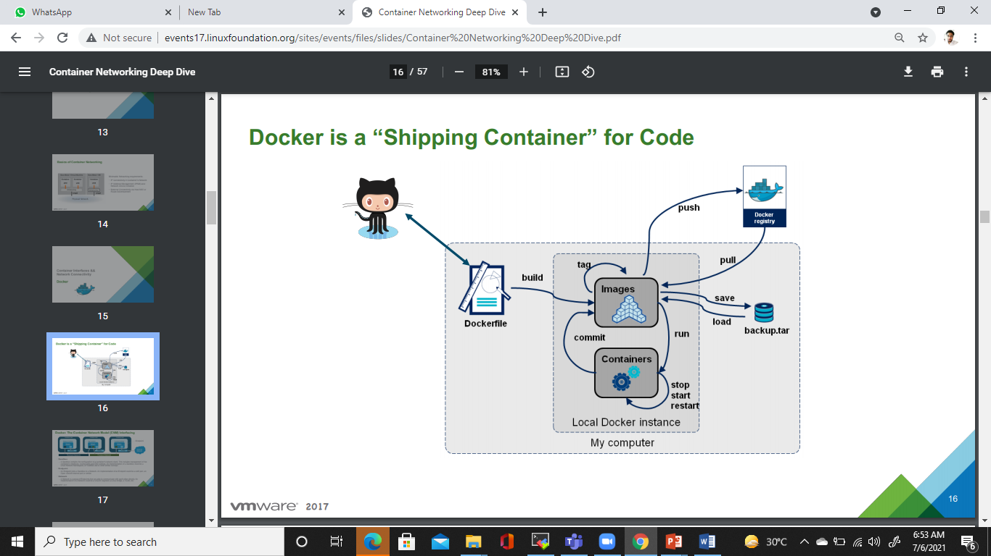

Slide 40


Slide 41
Docker install
sudo apt-get update
sudo apt-get install \
apt-transport-https \
ca-certificates \
curl \
gnupg \
lsb-release

Slide 42
Docker Install
curl -fsSL https://download.docker.com/linux/ubuntu/gpg | sudo gpg --dearmor -o /usr/share/keyrings/docker-archive-keyring.gpg
echo \
"deb [arch=amd64 signed-by=/usr/share/keyrings/docker-archive-keyring.gpg] https://download.docker.com/linux/ubuntu \
$(lsb_release -cs) stable" | sudo tee /etc/apt/sources.list.d/docker.list > /dev/null
sudo apt-get update
sudo apt-get install docker-ce docker-ce-cli containerd.io

Slide 43
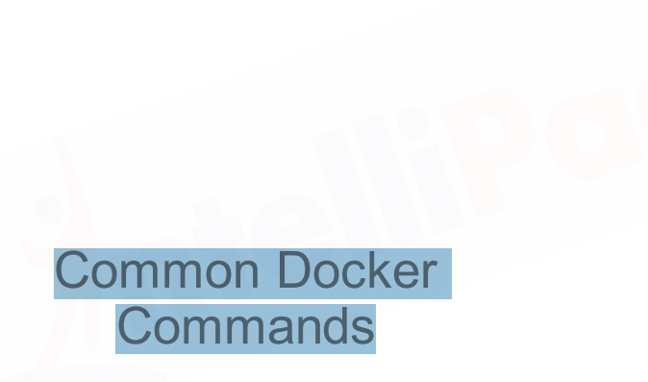

Slide 44
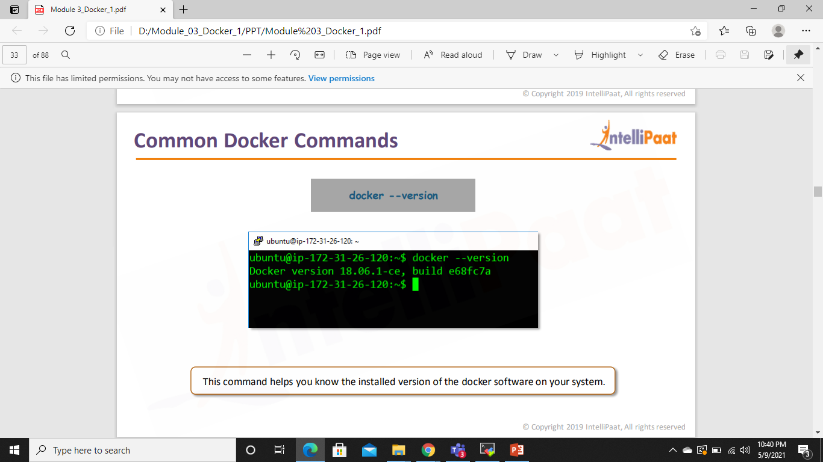
Common Docker Commands

Slide 45
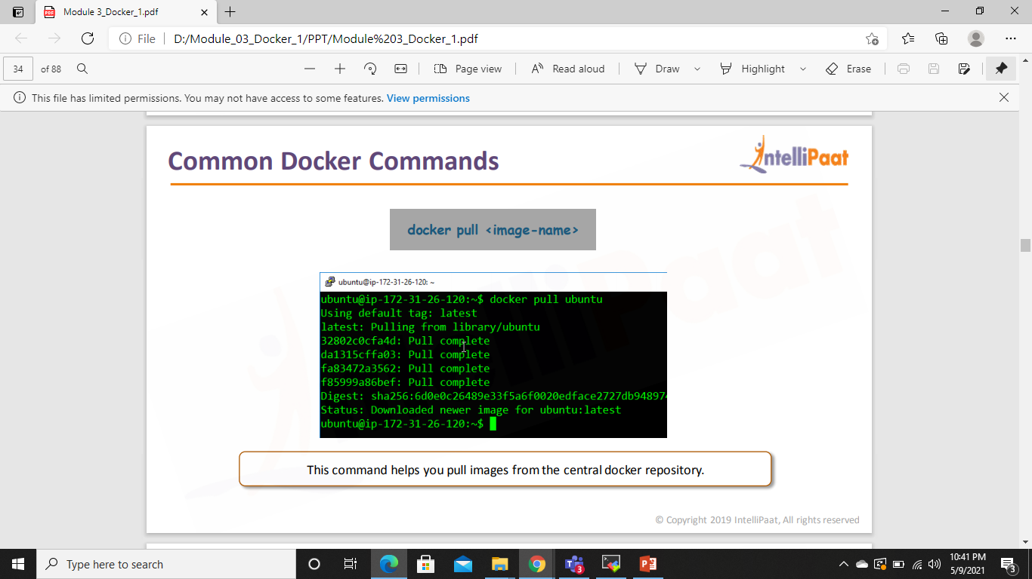
Common Docker Commands

Slide 46
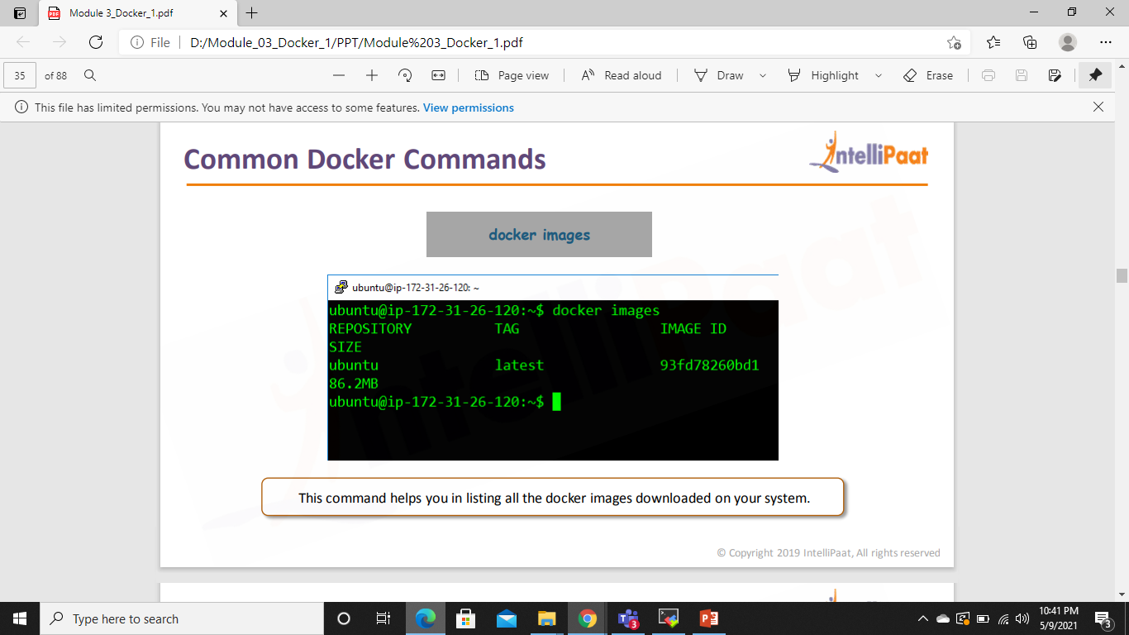
Common Docker Commands

Slide 47
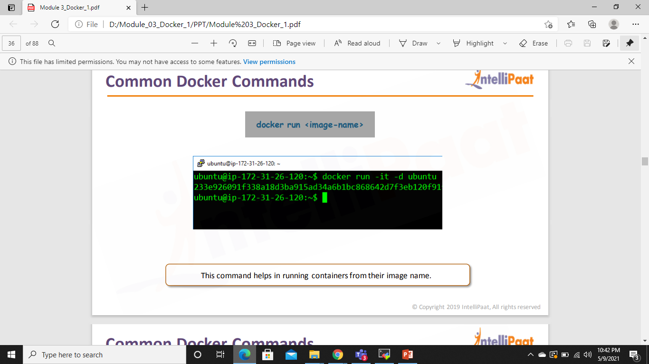
Common Docker Commands

Slide 48
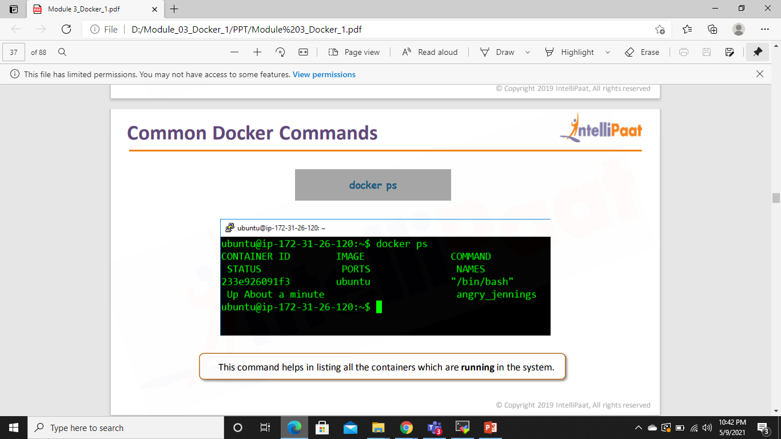
Common Docker Commands

Slide 49
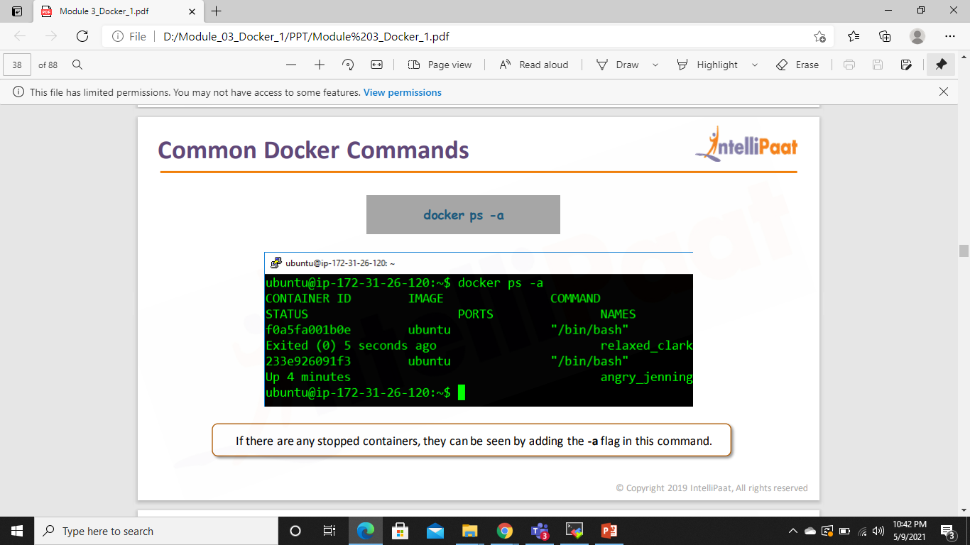
Common Docker Commands

Slide 50
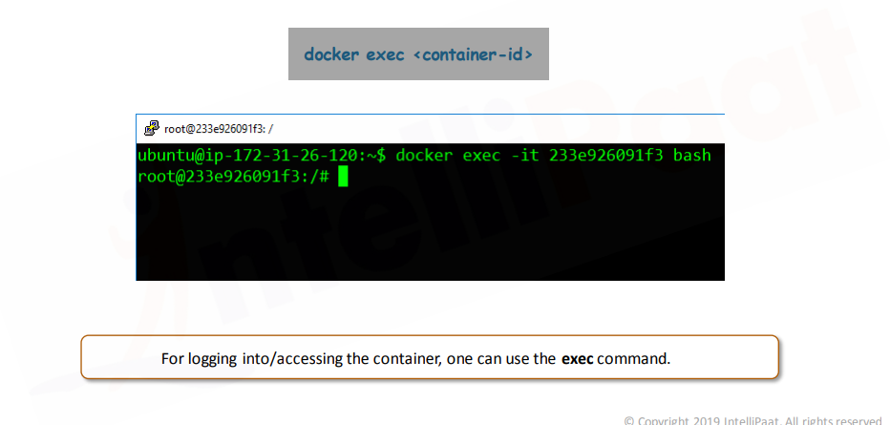
Common Docker Commands

Slide 51
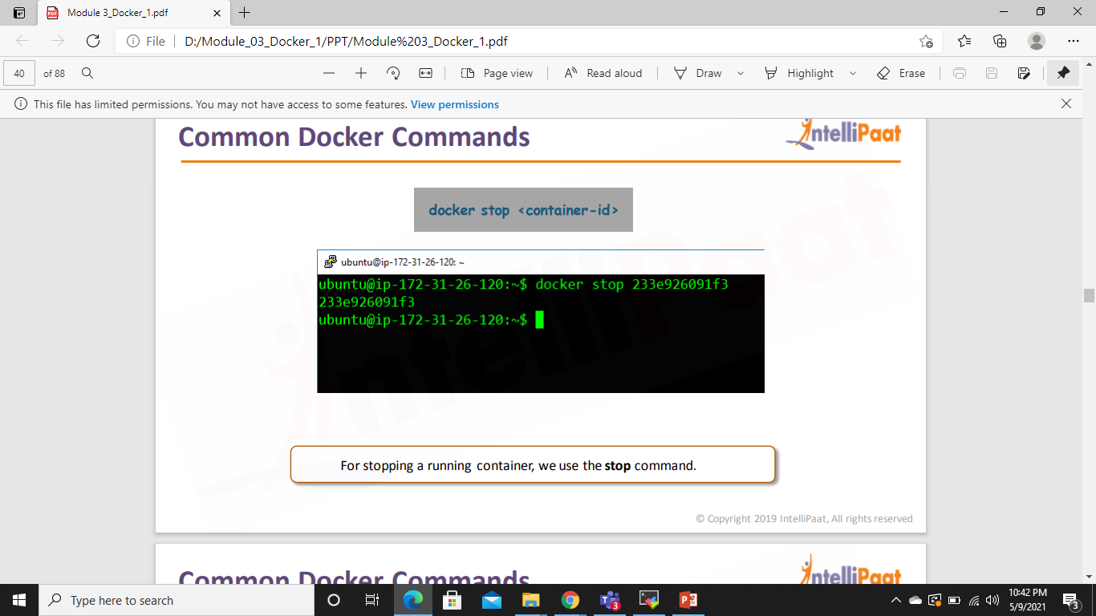
Common Docker Commands

Slide 52
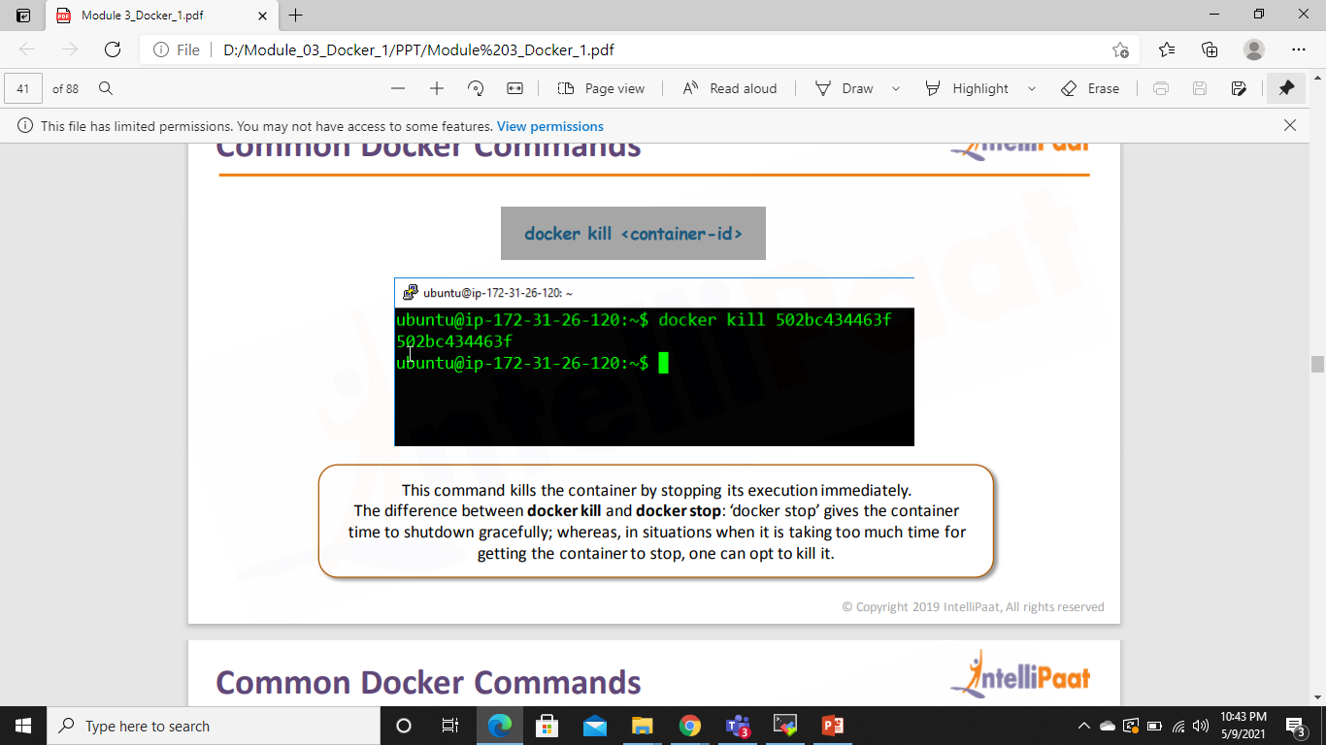
Common Docker Commands

Slide 53
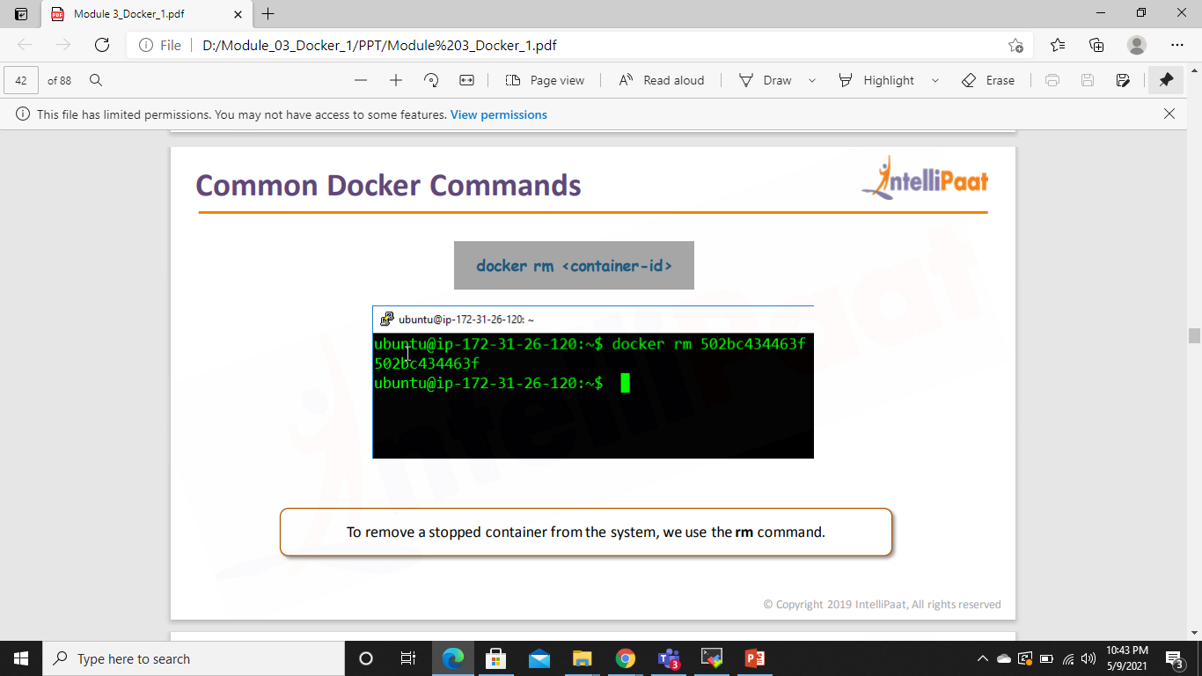
Common Docker Commands

Slide 54
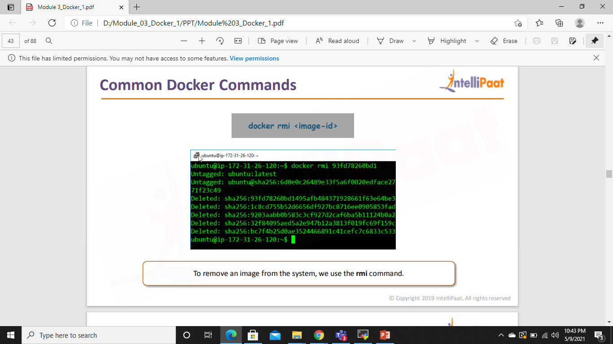
Common Docker Commands

Slide 55
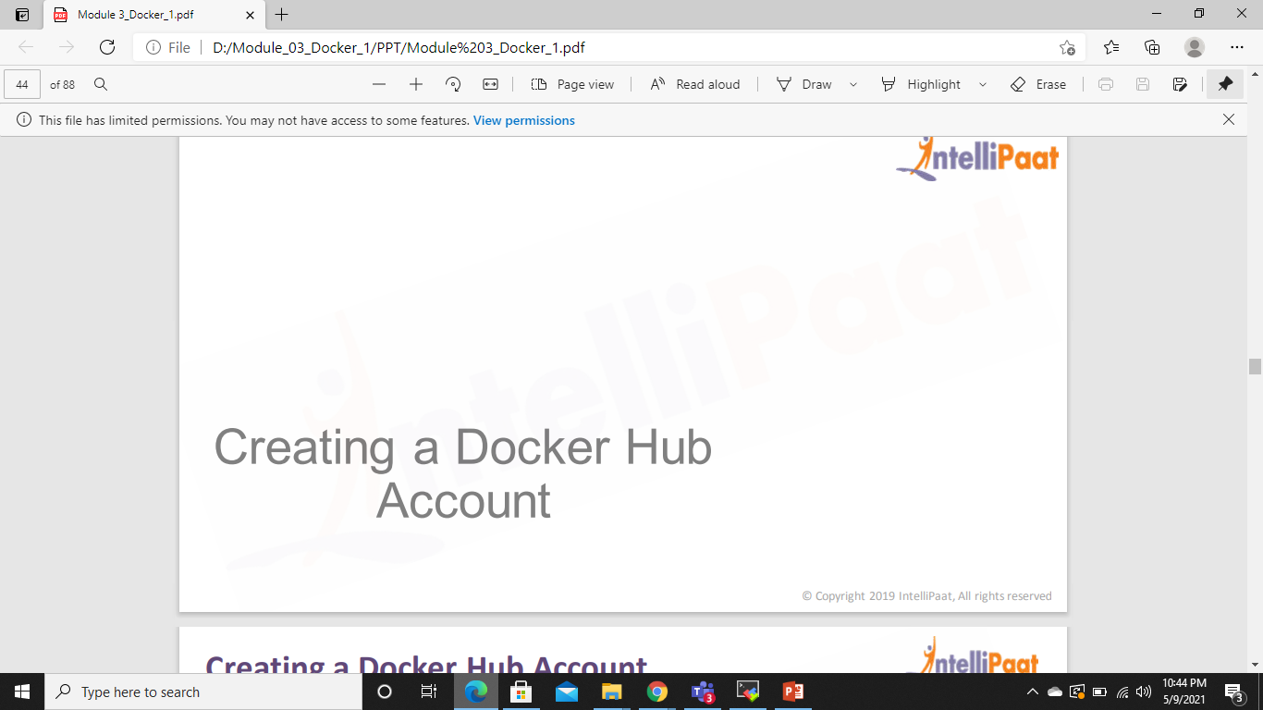

Slide 56
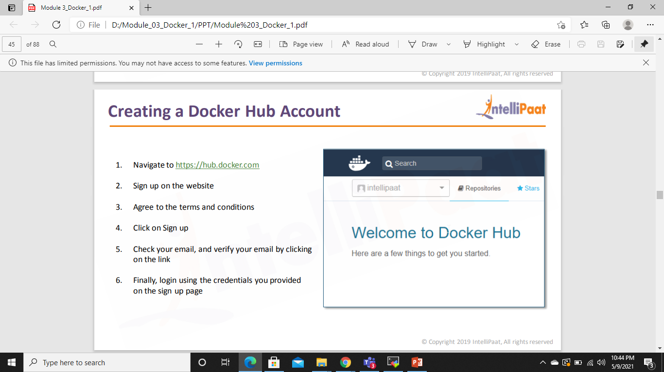
Docker Hub Account

Slide 57
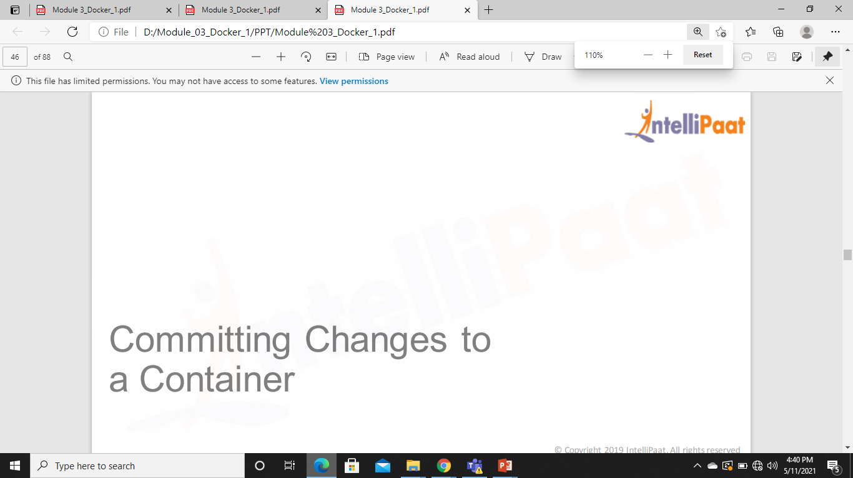

Slide 58
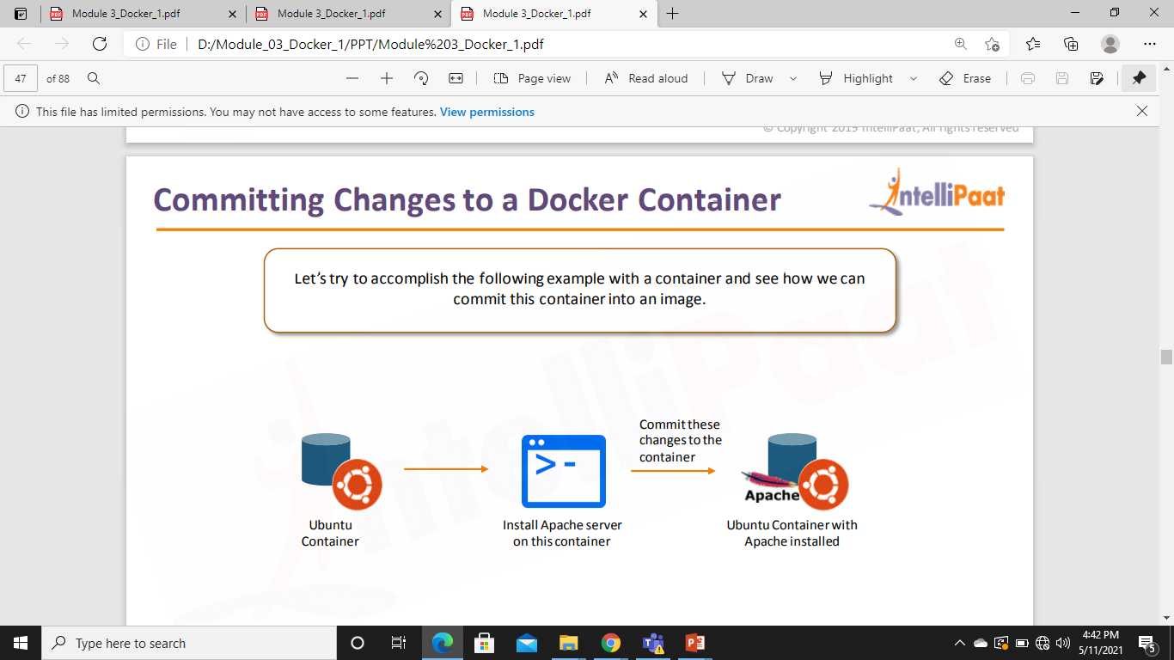
Committing Changes to a Container

Slide 59
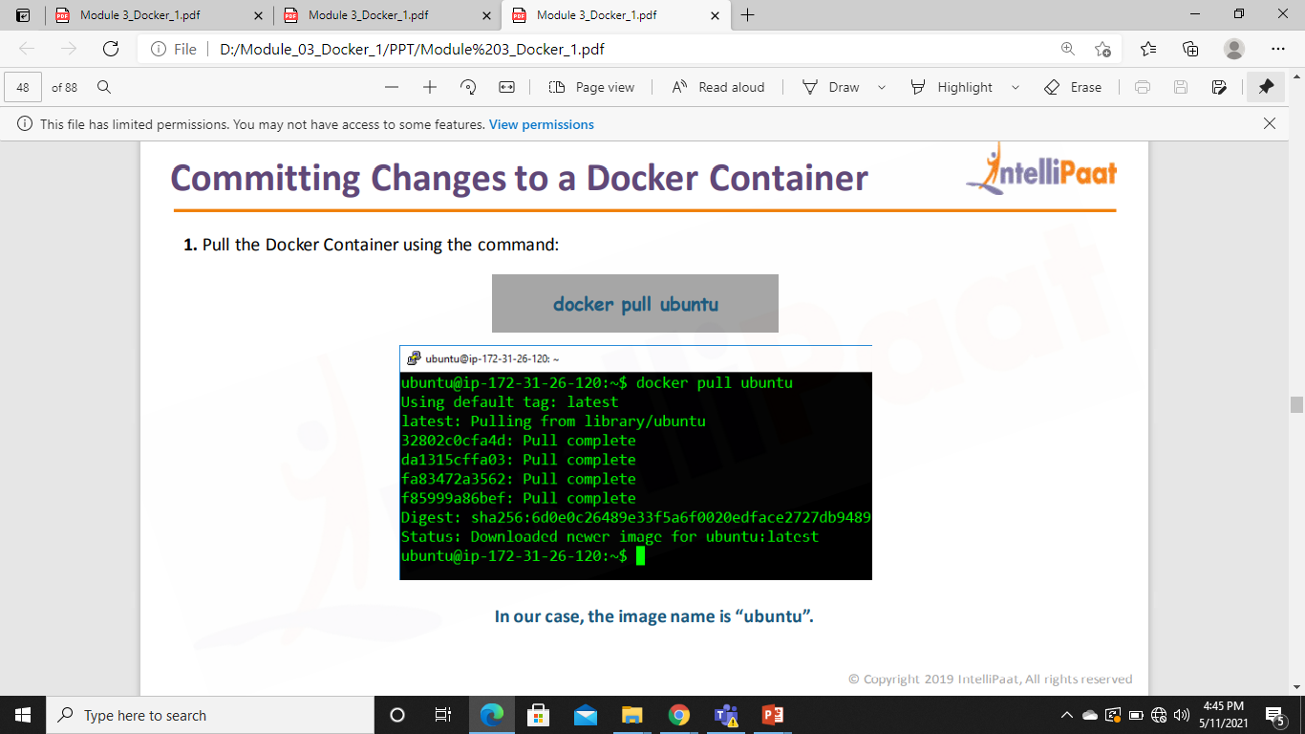
Committing Changes to a Container

Slide 60
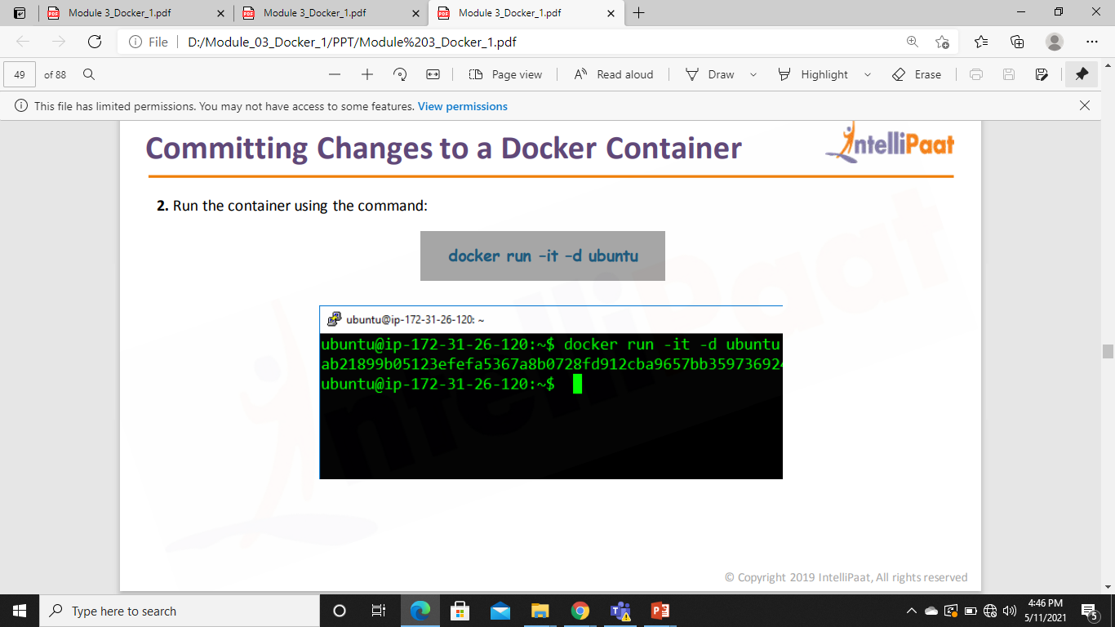
Committing Changes to a Container

Slide 61

Committing Changes to a Container

Slide 62

Committing Changes to a Container

Slide 63


Committing Changes to a Container

Slide 64


Slide 65
Pushing the Container on Docker Hub
docker login
Docker push <username>/container name

Slide 66


Slide 67
Dockerfile
Docker can build images automatically by reading the instructions from a Dockerfile.
A Dockerfile is a text document that contains all the commands a user could call on the command line to assemble an image.
Using docker build users can create an automated build that executes several command-line instructions in succession.

Slide 68


Slide 69


Slide 70
CREATING A DOCKERFILE
Step 1: First, create a folder docker, in the home directory
$ mkdir docker
Step 2: Enter into this directory, and create a file called ‘Dockerfile’, with the same contents as the Sample Dockerfile. Add the following content in the Dockerfile
$ cd docker
$ sudo vi Dockerfile

Slide 71
CREATING A DOCKERFILE
FROM ubuntu
ARG DEBIAN_FRONTEND=noninteractive
RUN apt-get update
RUN apt-get -y install apache2
ADD . /var/www/html
ENTRYPOINT apachectl -D FOREGROUND
ENV name Devops krishtech

Slide 72


Slide 73


Slide 74


Slide 75


Slide 76


Slide 77
CREATING A DOCKERFILE
Step 3: Create one more file called, index.html with the following contents can verify the push on DockerHub.
$ sudo vi index.html
<html>
<title> Sample Website </title>
<body>
Hello World
</body>
</html>

Slide 78
CREATING A DOCKERFILE
Step 4: Now pass the following command
$ docker build <directory-of-dockerfile> -t <name of image>
Step 5: Finally, run this built image, using the following command
$ docker run –it –p 81:80 –d <name of image>

Slide 79
Exact Dockerfile
FROM ubuntu
ARG DEBIAN_FRONTEND=noninteractive
RUN apt-get update
RUN apt-get -y install apache2
ADD . /var/www/html
ENTRYPOINT apachectl -D FOREGROUND
EXPOSE 80
ENV name Devops krishtech

Slide 80

CREATING A DOCKERFILE
Step 6: Now navigate to the server IP address on port 81

Slide 81
CREATING A DOCKERFILE
Step 7: Finally, login into the container, and check the variable $name, it will have the same value, as given in the Dockerfile.
https://stackoverflow.com/questions/32919515/advantages-of-a-dockerfile

